Slide 1
NAME:pandey shrushty vijayNarayan
STD: BCA-SEM6
Enrollment NO:22020111432
Subject:Cyber Security
College:Bhagwan Mahavir University
En2202020111432

Slide 2
Cyber Security
Cybersecurity is the practice of protecting digital
systems and data from cyberattacks.
en:2202020111432

Slide 3
what is cyber security.....
Cybersecurity is the practice of protecting computer systems, networks, and data from unauthorized access, use, disclosure, disruption, modification, or destruction. It encompasses various methods, processes, tools, and behaviors to safeguard digital assets from cyber threats.
En:22020201114332

Slide 4
Why Cyber Security Is Important...
Cybersecurity is crucial because it protects personal, financial, and business information from hackers, malware, and cyber threats. In today's digital world, almost everything—banking, shopping, communication, healthcare, and even national security—relies on the internet. Without cybersecurity, data breaches, identity theft, and financial losses can happen easily

Slide 5

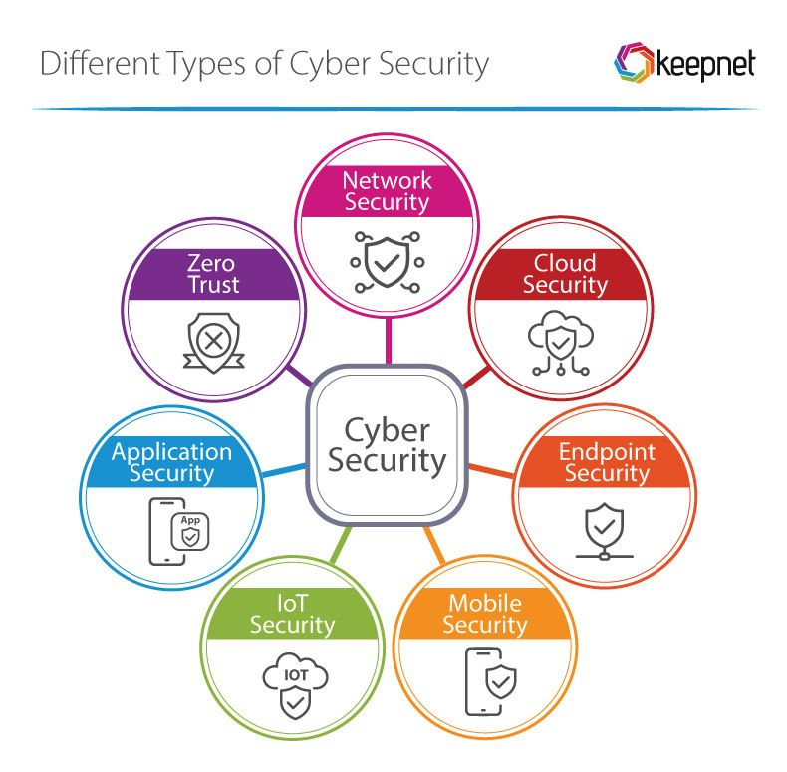
Types of cyber security
EN:2202020111432

Slide 6
1.Network Security...
Network security involves protecting a computer network from unauthorized access, misuse, or attacks, using tools, technologies, and policies to ensure data safety and integrity.
Importance..
In an increasingly interconnected world, where data is constantly flowing across networks, network security is crucial for maintaining confidentiality, integrity, and availability of information.
EN:2202020111432

Slide 7
2.Cloud Security
Cloud security encompasses the policies, technologies, and practices used to protect data, applications, and infrastructure hosted in the cloud from internal and external threats, ensuring confidentiality, integrity, and availability.
Importance..
Cloud security is important because it protects sensitive data and infrastructure from cyberattacks, data breaches, and unauthorized access. It also helps businesses comply with regulations.
EN:2202020111432

Slide 8
3.Endpoint Security
Endpoint security refers to the practices and technologies used to protect end-user devices (like laptops, desktops, and mobile phones) from malicious software and cyber threats, ensuring they remain secure when accessing corporate networks and resource..
Importance..
Endpoint security is crucial because endpoints, like laptops and smartphones, are often the first point of attack for cybercriminals and can lead to breaches, data theft, and reputational damage, making robust security measures essential.
EN:2202020111432

Slide 9
4.Mobile Security...
Mobile security involves protecting mobile devices and data from various threats, including malware, phishing, and unauthorized access, through strategies, infrastructure, and software.
Importance..
Mobile security is crucial for safeguarding sensitive data, preventing cyberattacks, and maintaining privacy in an increasingly connected world where mobile devices store personal and business information
EN:2202020111432

Slide 10
5.IOT Security...
IoT security focuses on protecting connected devices, networks, and data from unauthorized access and cyber threats, encompassing strategies like strong authentication, encryption, and secure firmware updates.
Importance..
IoT security is crucial because it protects the vast network of connected devices from cyber threats, safeguarding data, privacy, and the functionality of critical systems, from smart homes to industrial infrastructure.
EN:2202020111432

Slide 11
6.Application Securtity...
Application security (AppSec) is the practice of identifying and addressing vulnerabilities in software applications to prevent unauthorized access, modification, or misuse throughout their lifecycle, from development to deployment.
Importance...
Application security is crucial because it safeguards software applications and the sensitive data they handle from cyberattacks and vulnerabilities, protecting businesses from financial losses, reputational damage, and legal repercussions.
EN:2202020111432

Slide 12
7.ZERO Security...
Zero Trust security is a security model that assumes no user or device, regardless of location or network, should be trusted by default, requiring strict identity verification and authorization for every access request.
Importance....
Zero Trust security is crucial because it shifts from trusting users and devices within a network to verifying them at every access point, significantly reducing the risk of breaches and limiting the impact of security incidents by minimizing the attack surface and enforcing strict access controls.
EN:2202020111432

Slide 13
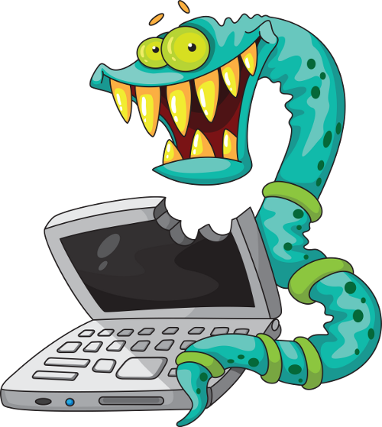
Computer Viruses: Unmasking the Threats in the Digital World
computer viruses affect the computer many ways.it can distroy data,files or programs.
the distructive effects of
viruses are different according to their types.
EN:2202020111432

Slide 14
what does computer viruses do?
Infect Files & Programs – Viruses attach themselves to files, software, or system processes.
Spread to Other Devices – They replicate and spread through email attachments, USB drives, networks, or the internet.
Cause Damage – Some viruses delete files, corrupt data, slow down systems, or even make computers unusable.
Steal Information – Certain viruses, like keyloggers or spyware, capture sensitive data such as passwords and credit card details.
Give Hackers Control – Some viruses create backdoors, allowing hackers to control your system remotely.
EN:2202020111432

Slide 15
Exploring the Different Types of Computer Viruses
Definition
Virus might attach itself to a program such as spreadsheet. Each time the spreadsheet program runs, the virus runs too and replicate itself.
Types With Examples
Trojan Virus (ILU) | Worms Virus (Morris Worm) | Adware Virus (infinite Popups And Fireball) | Spyware Virus (Pegasus And Camphisher)
Rouge Virus (Winfixer) | Ransomware Virus (wannacry) | Rootkit Virus (Rustock And Necurs) | Polymorphic Virus (Beebone)
EN:2202020111432

Slide 16
Analyzing the Impact of the Listed Viruses
Trojan Virus
(ILU)
Worms Virus
(Morris Worm)
Adware Virus
(infinite Popups And Fireball)
Spyware Virus
(Pegasus And Camphisher)
EN:2202020111432

Slide 17
Analyzing the Impact of the Listed Viruses
Rouge Virus
(Winfixer)
Ransomware Virus
(wannacry)
Rootkit Virus
(Rustock And Necurs)
Polymorphic Virus
(Beebone)
EN:2202020111432

Slide 18
Protecting Against Computer Viruses: Effective Solutions
Windows Defender
SIMANTEC
MCAFEE
ESET NODE32
QUICKHRAL
NORTON
NP-AV
AVAST
360 TOTAL SECURITY
BITDEFENDER
MALWAREBYTE
F-SECURE
EN:2202020111432

Slide 19
Keep Your System Secure..
Update your operating system and software.
Install a strong antivirus and enable firewall protection.
Avoid clicking on suspicious links, pop-ups, or attachments.
Back up important files to an external drive or cloud storage.
EN:2202020111432

Slide 20
Security....
Firewall:
A firewall is a security system that monitors and controls incoming and outgoing network traffic. It acts as a barrier between your computer (or network) and potential cyber threats, blocking unauthorized access while allowing safe connections.
EN:2202020111432

Slide 21
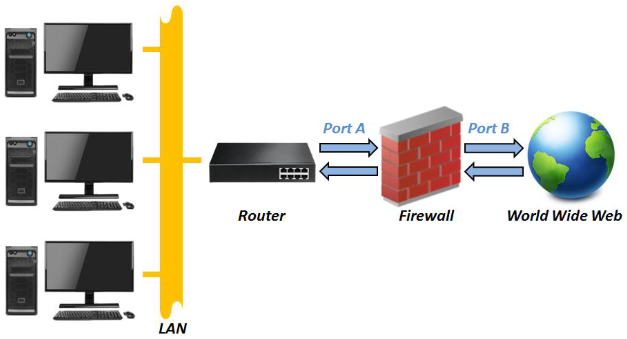
How firewall Works....
EN:2202020111432

Slide 22
VPN(Virtual private Network)...
A VPN (Virtual Private Network) is a security tool that encrypts your internet connection, hiding your IP address and protecting your online activity from hackers, ISPs, and government surveillance.
EN:2202020111432

Slide 23
1. You Connect to a VPN Server
When you turn on a VPN, your device (phone, laptop, etc.) connects to a remote VPN server in a location of your choice.
EN:2202020111432

Slide 24
2. Your Data is Encrypted
Before your data is sent to the internet, the VPN encrypts it (scrambles it into unreadable code).
This prevents hackers, ISPs, or governments from seeing what you’re doing online.
EN:2202020111432

Slide 25
3. Your IP Address is Hidden
Instead of using your real IP address, the VPN assigns you a new one from the server location you chose.
This makes it look like you’re browsing from a different country, helping with privacy and unblocking restricted content.
EN:2202020111432

Slide 26
4. You Access the Internet Securely...
Websites, streaming services, and apps see the VPN’s IP address instead of yours.
Your real location and identity stay hidden.
EN:2202020111432

Slide 27
What Is Cyber Attacks...
A cyber attack is an attempt by hackers to steal, damage, or disrupt computer systems, networks, or data. These attacks can target individuals, businesses, or even governments.
EN:2202020111432

Slide 28
Phishing Attack..
What it does: Tricks people into revealing personal information like passwords and credit card details.
Example: A fake email from "your bank" asking for login details.
Prevention: Never click suspicious links, check email senders carefully, and use two-factor authentication (2FA).
EN:2202020111432

Slide 29
Password Attacks (Brute Force, Credential Stuffing)..
What it does: Hackers try multiple passwords until they guess the right one.
Example: Attackers use leaked passwords from data breaches to break into accounts.
Prevention: Use strong, unique passwords and enable multi-factor authentication (MFA).
EN:2202020111432

Slide 30
Denial of Service (DoS) & Distributed.Denial of Service (DDoS) Attacks..
What it does: Overloads a website or system with traffic, making it crash.
Example: Attackers flood a website with requests, making it unavailable for real users.
Prevention: Use firewalls, anti-DDoS protection, and limit unnecessary network access.
EN:2202020111432

Slide 31
Man-in-the-Middle (MitM) Attack
What it does: Hackers intercept communication between two parties to steal sensitive data.
Example: A hacker on a public Wi-Fi network steals your login details.
Prevention: Use a VPN, avoid public Wi-Fi for banking, and enable HTTPS on websites.
EN:2202020111432

Slide 32
SQL Injection...
What it does: Hackers insert malicious SQL code into a website’s database to steal or alter data.
Example: An attacker retrieves customer credit card details from an unsecured database.
Prevention: Use secure coding practices and input validation.
EN:2202020111432

Slide 33
How to Protect Yourself from Cyber Attacks 🔒
✅ Use strong, unique passwords (with a password manager)
✅ Enable two-factor authentication (2FA)
✅ Keep software & devices updated
✅ Avoid clicking on suspicious links/emails
✅ Use a VPN on public Wi-Fi
✅ Install a firewall & antivirus software
✅ Back up important data regularly
EN:2202020111432

Slide 34
Types Of Hackers...
1.White Hat Hacker
2.Grey Hat Hacker
3.Black Hat Hacker
4.Blue Hat Hacker
EN:2202020111432

Slide 35
1.White Hat Hacker
A White Hat Hacker is an ethical hacker who uses their skills to identify and fix security vulnerabilities in computer systems, networks, or software. Unlike Black Hat Hackers (who exploit security flaws for malicious purposes), White Hat Hackers work legally and often help organizations improve cybersecurity.
EN:2202020111432

Slide 36
2.Grey Hat Hacker..
A Grey Hat Hacker is someone who falls between White Hat and Black Hat hackers. They may break into systems without permission but usually with good intentions—such as exposing security flaws—rather than for malicious purposes. However, their actions are still ethically questionable and often illegal because they don’t have explicit authorization.
EN:2202020111432

Slide 37
3.Black Hat Hacker..
A Black Hat Hacker is a cybercriminal who exploits security vulnerabilities for personal gain, financial profit, or malicious intent. Unlike White Hat Hackers (who use hacking for ethical and legal purposes) or Grey Hat Hackers (who operate in a moral gray area), Black Hat Hackers engage in illegal activities such as data theft, financial fraud, and cyberattacks.
EN:2202020111432

Slide 38
4.Blue Hat Hacker..
A Blue Hat Hacker is someone who tests security systems but does not work as an ethical hacker full-time. The term can have two meanings, depending on the context:
1. Microsoft Blue Hat Hackers
2. Revenge-Seeking Blue Hat Hackers
EN:2202020111432

Slide 39
1. Microsoft Blue Hat Hackers
Microsoft uses "Blue Hat" to describe security professionals or external experts invited to test software before release.
These hackers identify and fix vulnerabilities in Microsoft products before cybercriminals can exploit them.
Example: A security researcher hired for a Microsoft BlueHat Conference to test Windows security.
EN:2202020111432

Slide 40
2. Revenge-Seeking Blue Hat Hackers
Some use "Blue Hat Hacker" to describe individuals who hack for personal revenge rather than financial gain.
Unlike Black Hat Hackers, they don’t hack for profit but to get back at someone (e.g., hacking an ex’s social media).
This is illegal and unethical but not as organized as Black Hat cybercrime.
EN:2202020111432

Slide 41
Advantages Of Cyber Security..
The cyber security will defend us from critical attacks.
it helps us to browse the safe wabsite.
internet security process all the incoming and outgoing data on our computer.
EN:2202020111432

Slide 42
Conclusion..
Cybersecurity is essential in today’s digital world, protecting individuals, businesses, and governments from cyber threats. With the rise of hacking, malware, phishing, and data breaches, it is more important than ever to implement strong security measures.
EN:2202020111432

Slide 43
Thank You.....
“Stay Safe,
Stay Secure”
EN:2202020111432

